Slide 1
Classification of Epileptoid Oscillations in EEG using Shannon’s Entropy Amplitude Probability Distribution
Ronald Broberg and Rory Lewis
Department of Mathematics. University of Colorado at Colorado Springs and Department of Computer Science, University of Colorado at Colorado Springs.

Slide 2
Outline
The Challenge
Amplitude Entropy
Explorations
Experiment

Slide 3

Epileptic Seizures in EEG recordings
Categories
Interictal
Preictal
Ictal (seizure)
Postictal
Classification
Detection
Machine labeling
Prediction
Intervention
http://health-fts.blogspot.mx/2012/02/epilepsy.html

Slide 4
Public Data Sets
1990s – mid-2000s
Quiroga, Caltech, 3 minutes, 102Hz, single channel, single patient
Andrzejak , University of Bonn
5 classes, 100 files, 173.6 Hz, 23 second clips
Mid-2000s
University of Freiburg, 21 patients, 246 Hz, 6 channels
Mid-2000s – Present
PhysioNet, Childrens’ Hospital Boston / MIT (CHBMIT)
44 GiB, 256 Hz, 800 hours of ~4 hour clips
University of Pennsylvania, National Institute of Health, American Epilepsy Society
~100 GiB, 400-5000 Hz, 16-72 channels, 1 second clips, canine and human
Notes:
Volume, Velocity, Variety

Slide 5
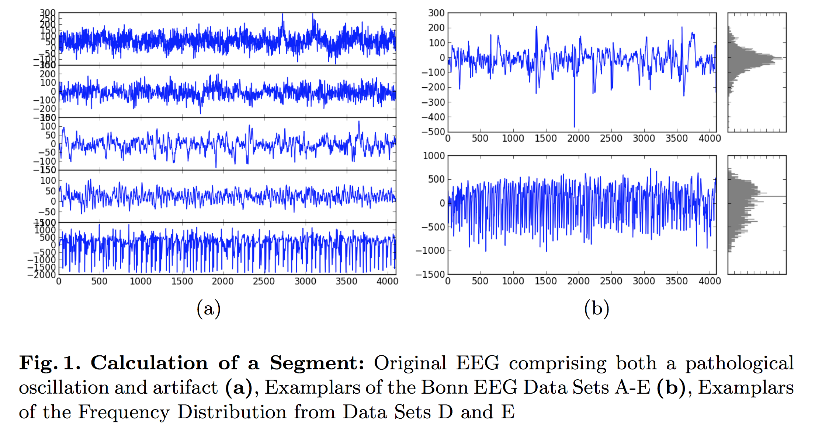
Entropy of Amplitude

Slide 6

Entropy of Amplitude

Slide 7
Explorations

Slide 8
Entropy of Amplitude

Slide 9
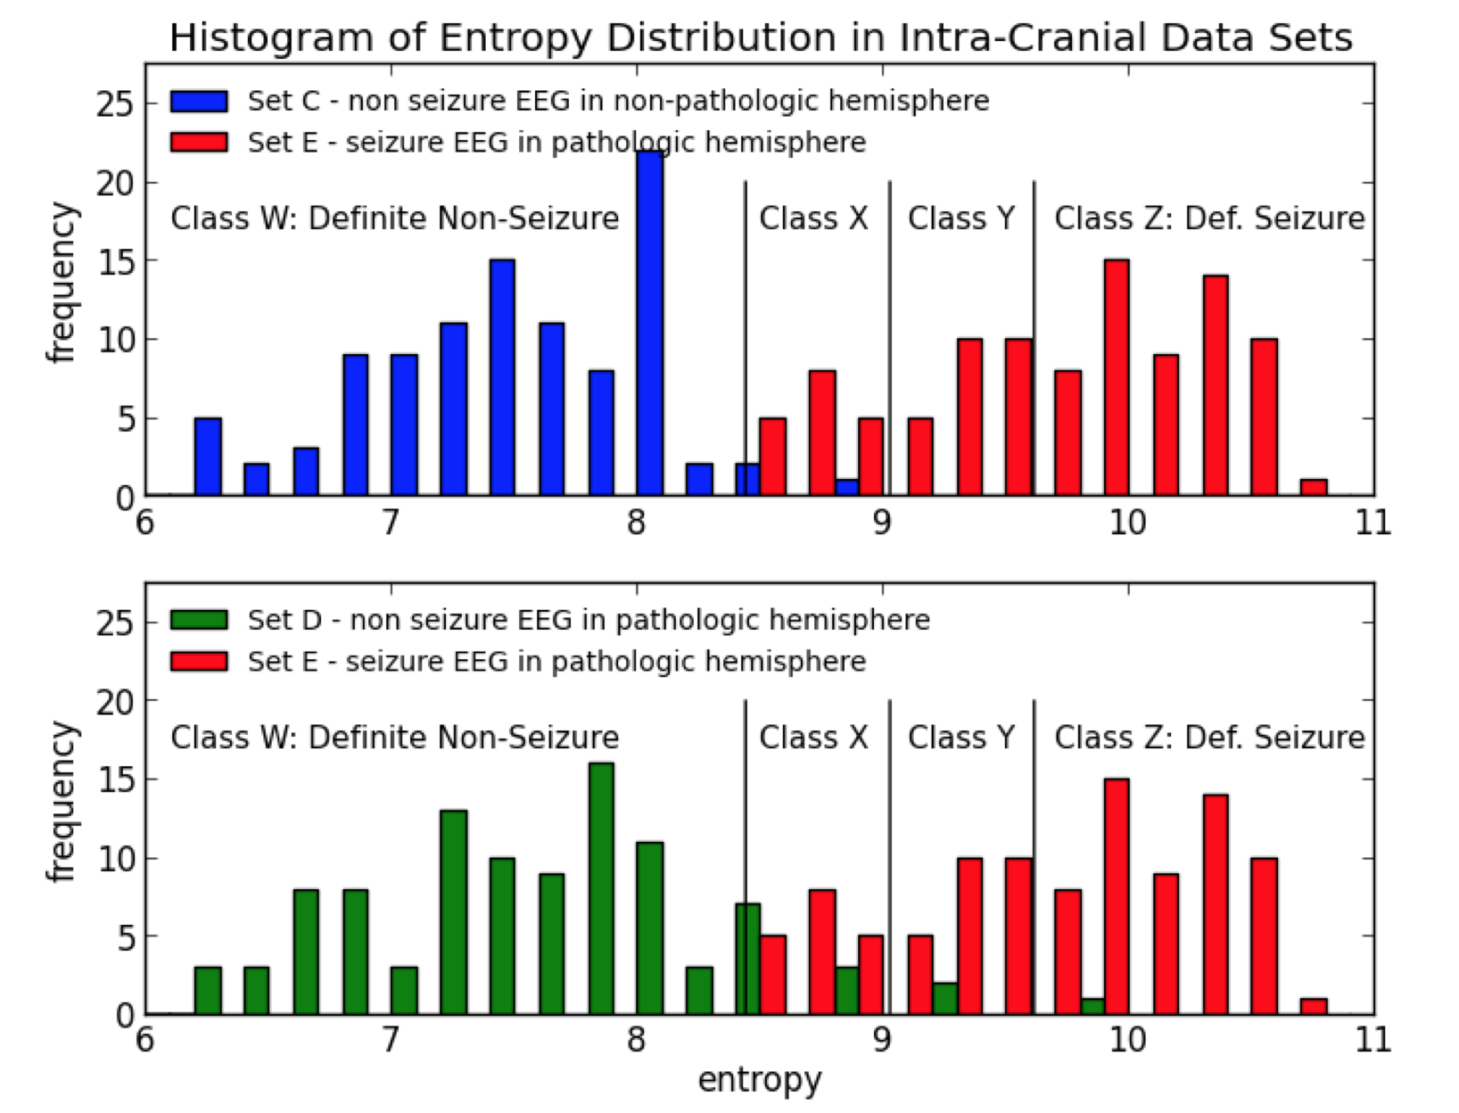
Classification by Amplitude Entropy

Slide 10
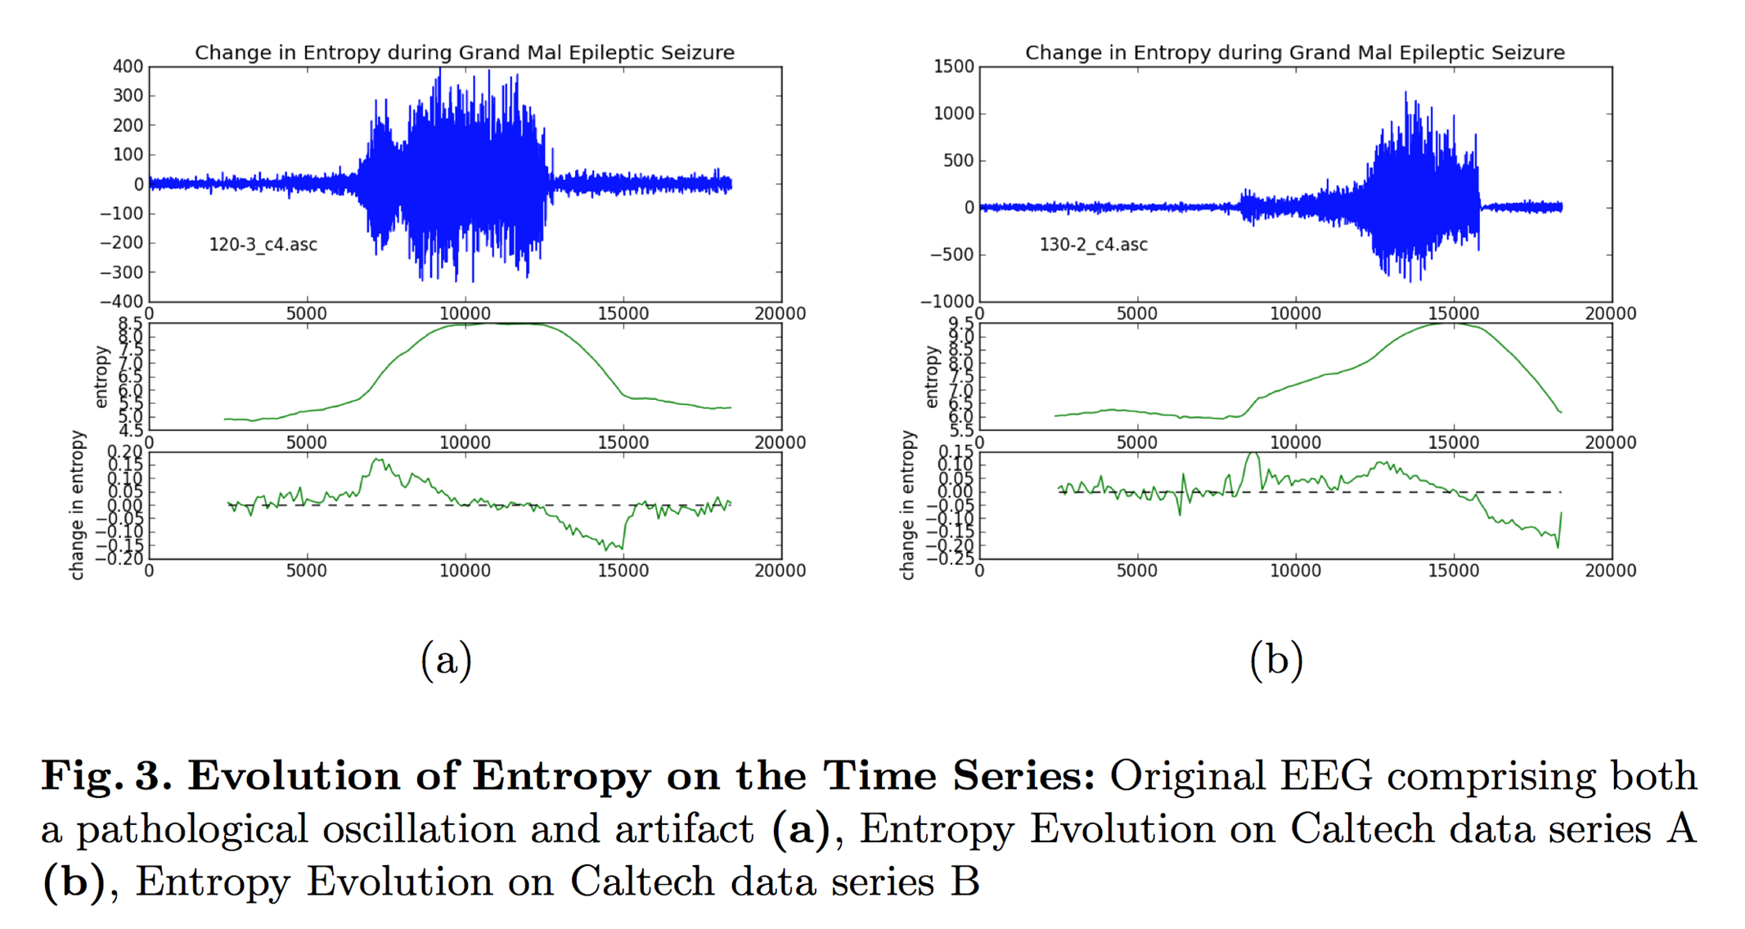
Entropy over Time

Slide 11
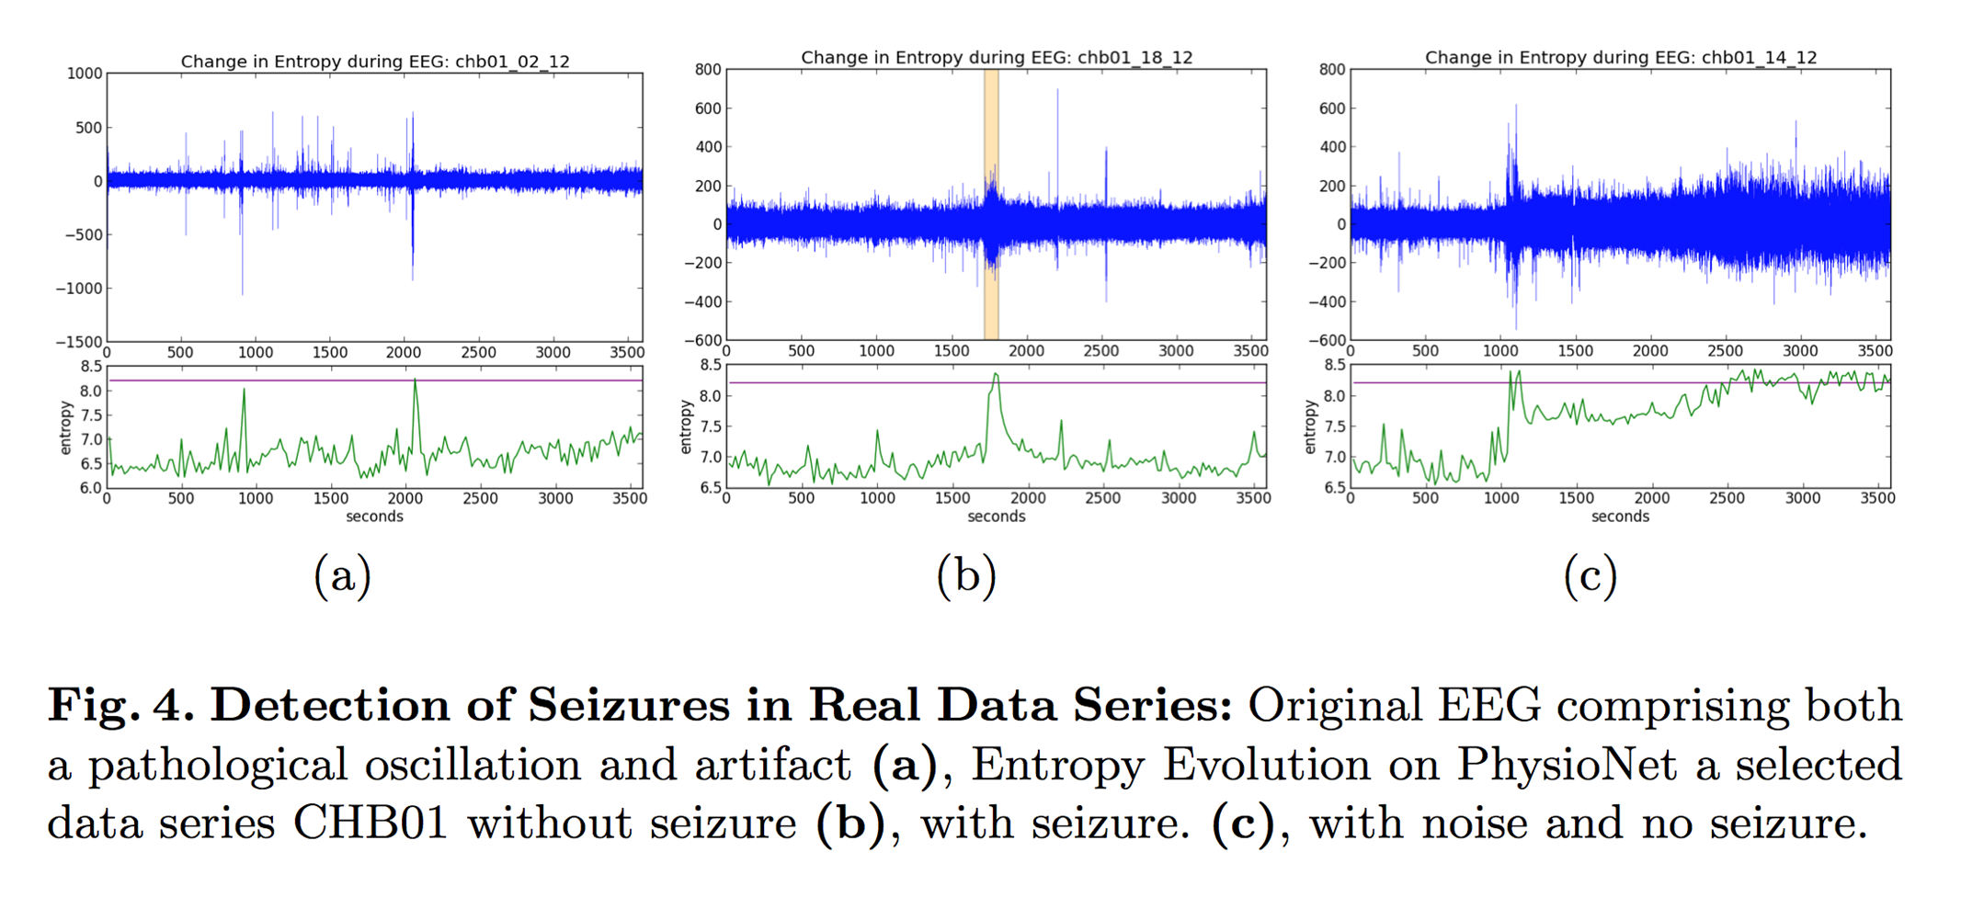
Amp Entropy in CHB/MIT

Slide 12
Experiment: Kaggle Challenge
University of Pennsylvania
Detect Seizure
4 Canine @ 400Hz / 8 Human @ 5000Hz
~ 100 GiB data
0.95810 AUC with Random Forest Classification
Univariate, Bivariate, and Multivariate Features.
Time Domain and Frequency Domain
0.00000 AUC extended with Amp Entropy

Slide 13
Questions

